Slide 1

AMSTer : SAR & InSAR Automated Mass processing Software for Multidimensional Time series
Nicolas d’Oreye^{1,2}, Dominique Derauw^{3,4}, Sergey Samsonov⁵,
Delphine Smittarello¹, Maxime Jaspard¹, Gilles Celli¹
ndo@ecgs.lu
amster@ecgs.lu
1 European Centre for Geodynamics and Seismology (ECGS), 19 rue Josy Welter, L-7256 Walferdange, Luxembourg
2 National Museum of Natural History (NMNH), 19 rue Josy Welter, L-7256 Walferdange, Luxembourg
3 Centre Spatial de Liège (CSL), Avenue du Pré Aily, B-4031 Angleur, Belgium
4 SAREOS, 1 Rue des Violettes, 4557 Fraiture, Belgium
5 Canada Centre for Mapping and Earth Observation, Natural Resources Canada (NRCAN), 560 Rochester Street, Ottawa, ON K1A 0E4, Canada
To crunch the SAR and InSAR mass processing
ndo@ecgs.lu

Slide 2
AMSTer : SAR & InSAR Automated Mass processing Software for Multidimensional Time series
Toolbox Structure
Nicolas d’Oreye

Slide 3

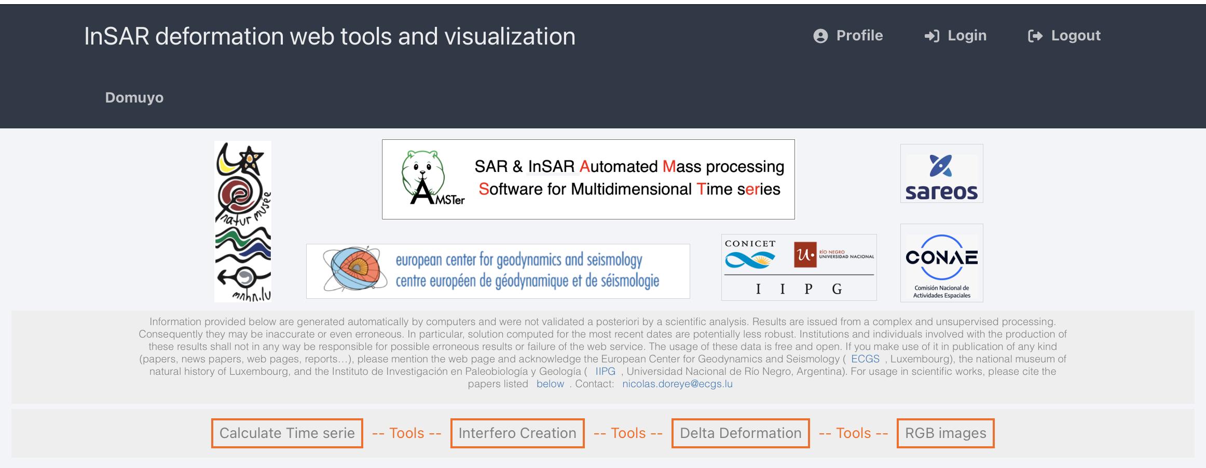
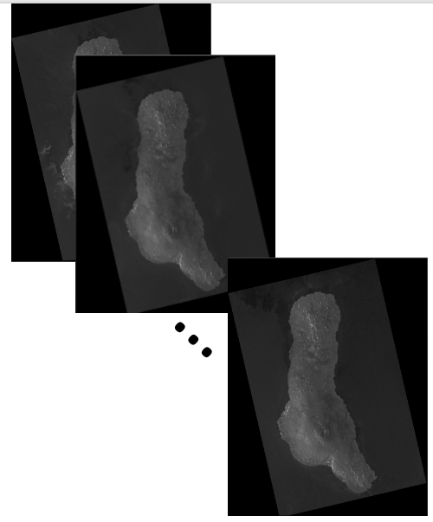
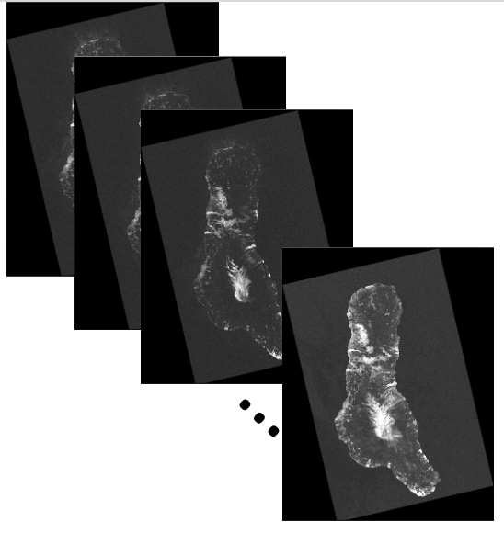
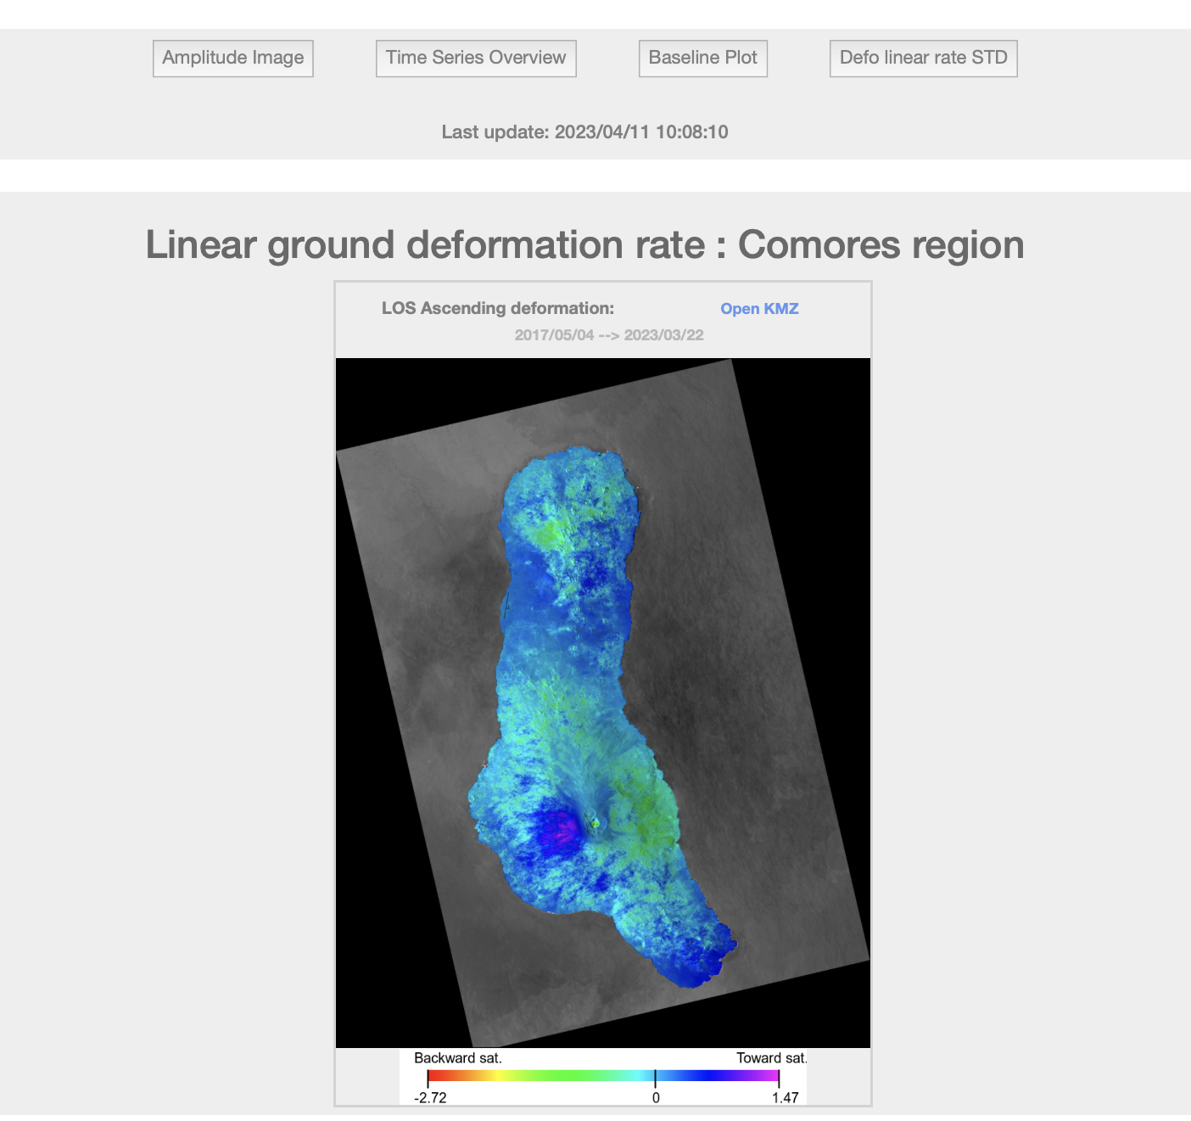
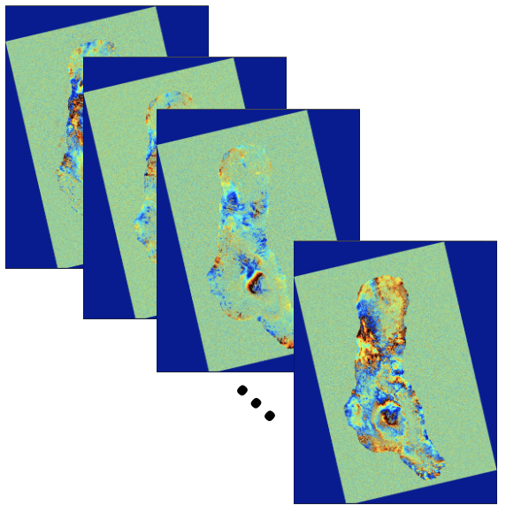
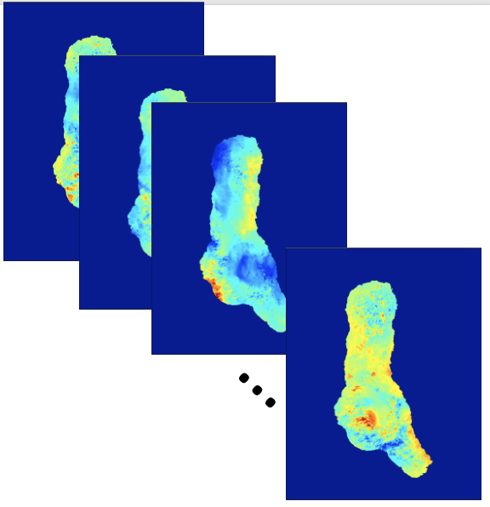
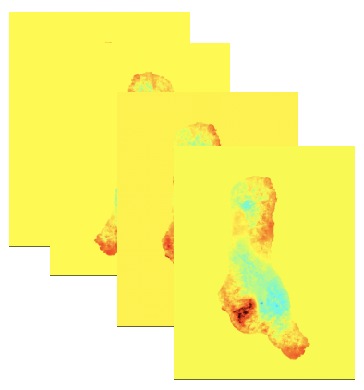
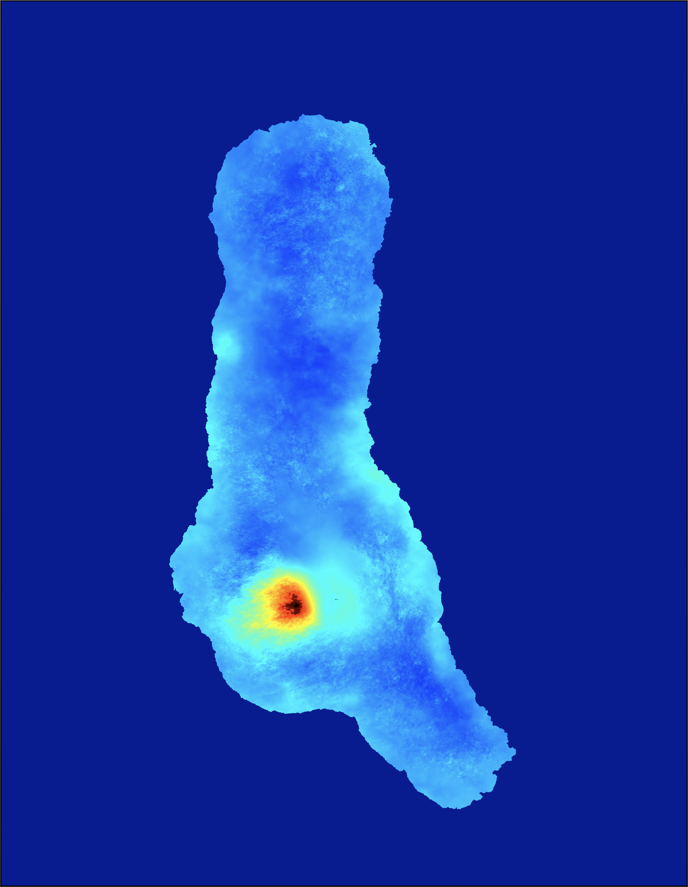
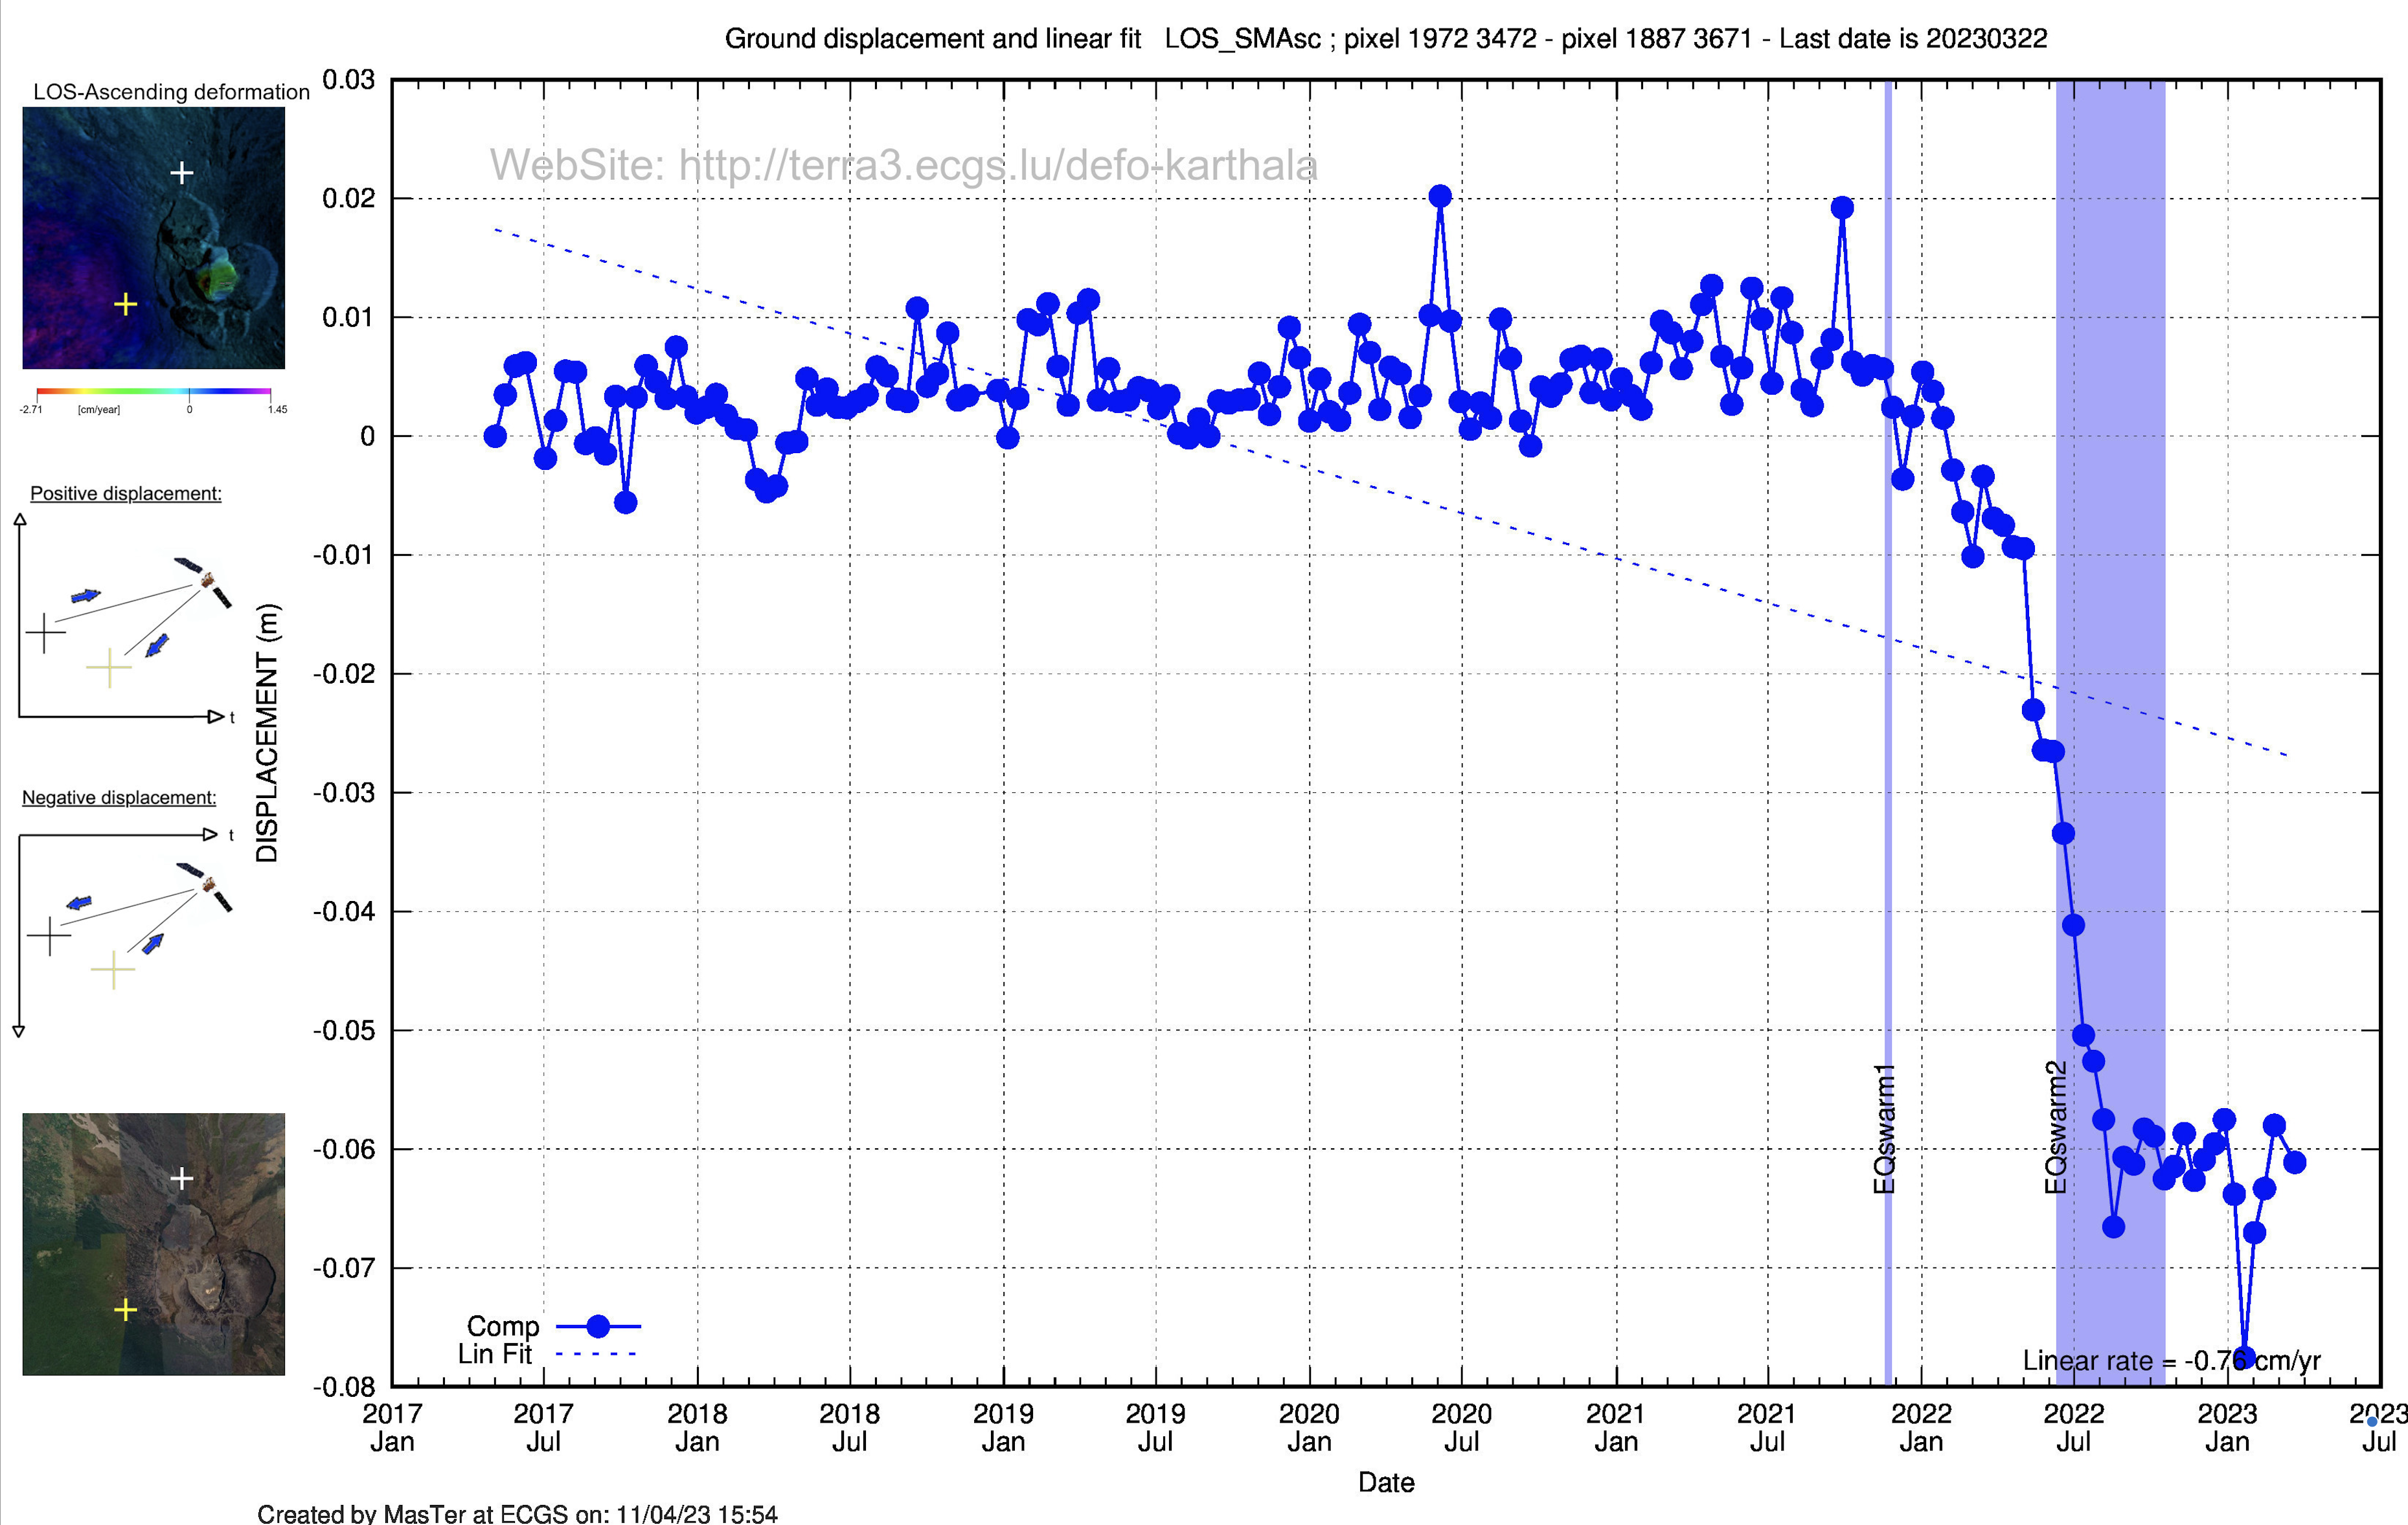
MasTer Toolbox
Sat. image
Download
Web Page(s)
Interferometric processing
(AMSTer Engine)
Ampli.
Coh.
Time Series processing
(MSBAS)
Ampli.
Defo.
Mean Veloc.
Interf.
Cumul. defo.
Defo.
Time series
G. Celli
D. Derauw
S. Samsonov
M. Jaspard
N. d’Oreye & D. Smittarello

Slide 4
Structure
Plan:
The user manual:
Conventions
Architecture
Contest…
Scripts architecture (header, hard coded lines..)
Organizing the work:
Disk/Directories architecture
AMSTer Organizer
Processing steps:
download,
read, (baseline computation)
Coregistration, InSAR processing, mass processing
Deformation time series (+ amplitude time series), web page
Parameters
Ancillary data:
DEM : where, how create, format
MASKS : where, how create, format
kml: where, why, how create

Slide 5
Structure
Plan:
The user manuals:
Conventions
Architecture
Contest…
Scripts architecture (header, hard coded lines..)
Organizing the work:
Disk/Directories architecture
AMSTer Organizer
Processing steps:
download,
read, (baseline computation)
Coregistration, InSAR processing, mass processing
Deformation time series (+ amplitude time series), web page
Parameters
Ancillary data:
DEM : where, how create, format
MASKS : where, how create, format
kml: where, why, how create
+ Provide samples (S1 data, DEM, orbits…) to participants

Slide 6
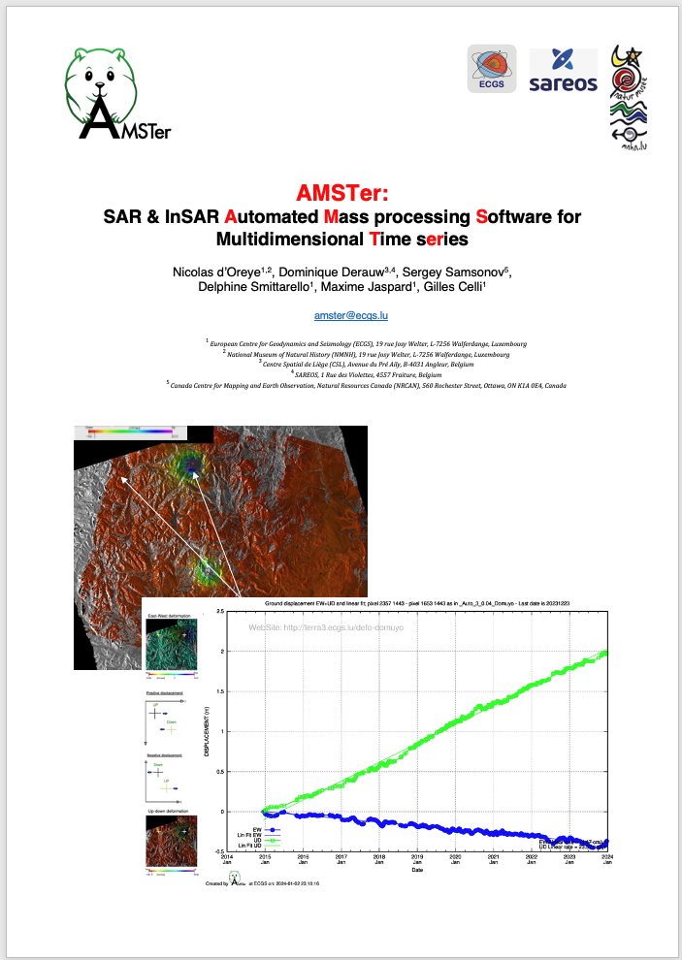
The user manual(s)
AMSTer_Manual_6.2.docx [or .pdf]
250 pages
Clickable table of contents ………………………(from page3)
List of figures…………………………………………..(from page 238)
Index of scripts, variables, files names…….(from page 241)
Some references……………………………………..(from page 250)
Everything should be in there…
➔ Go through the manual to know what exists and where.

Slide 7
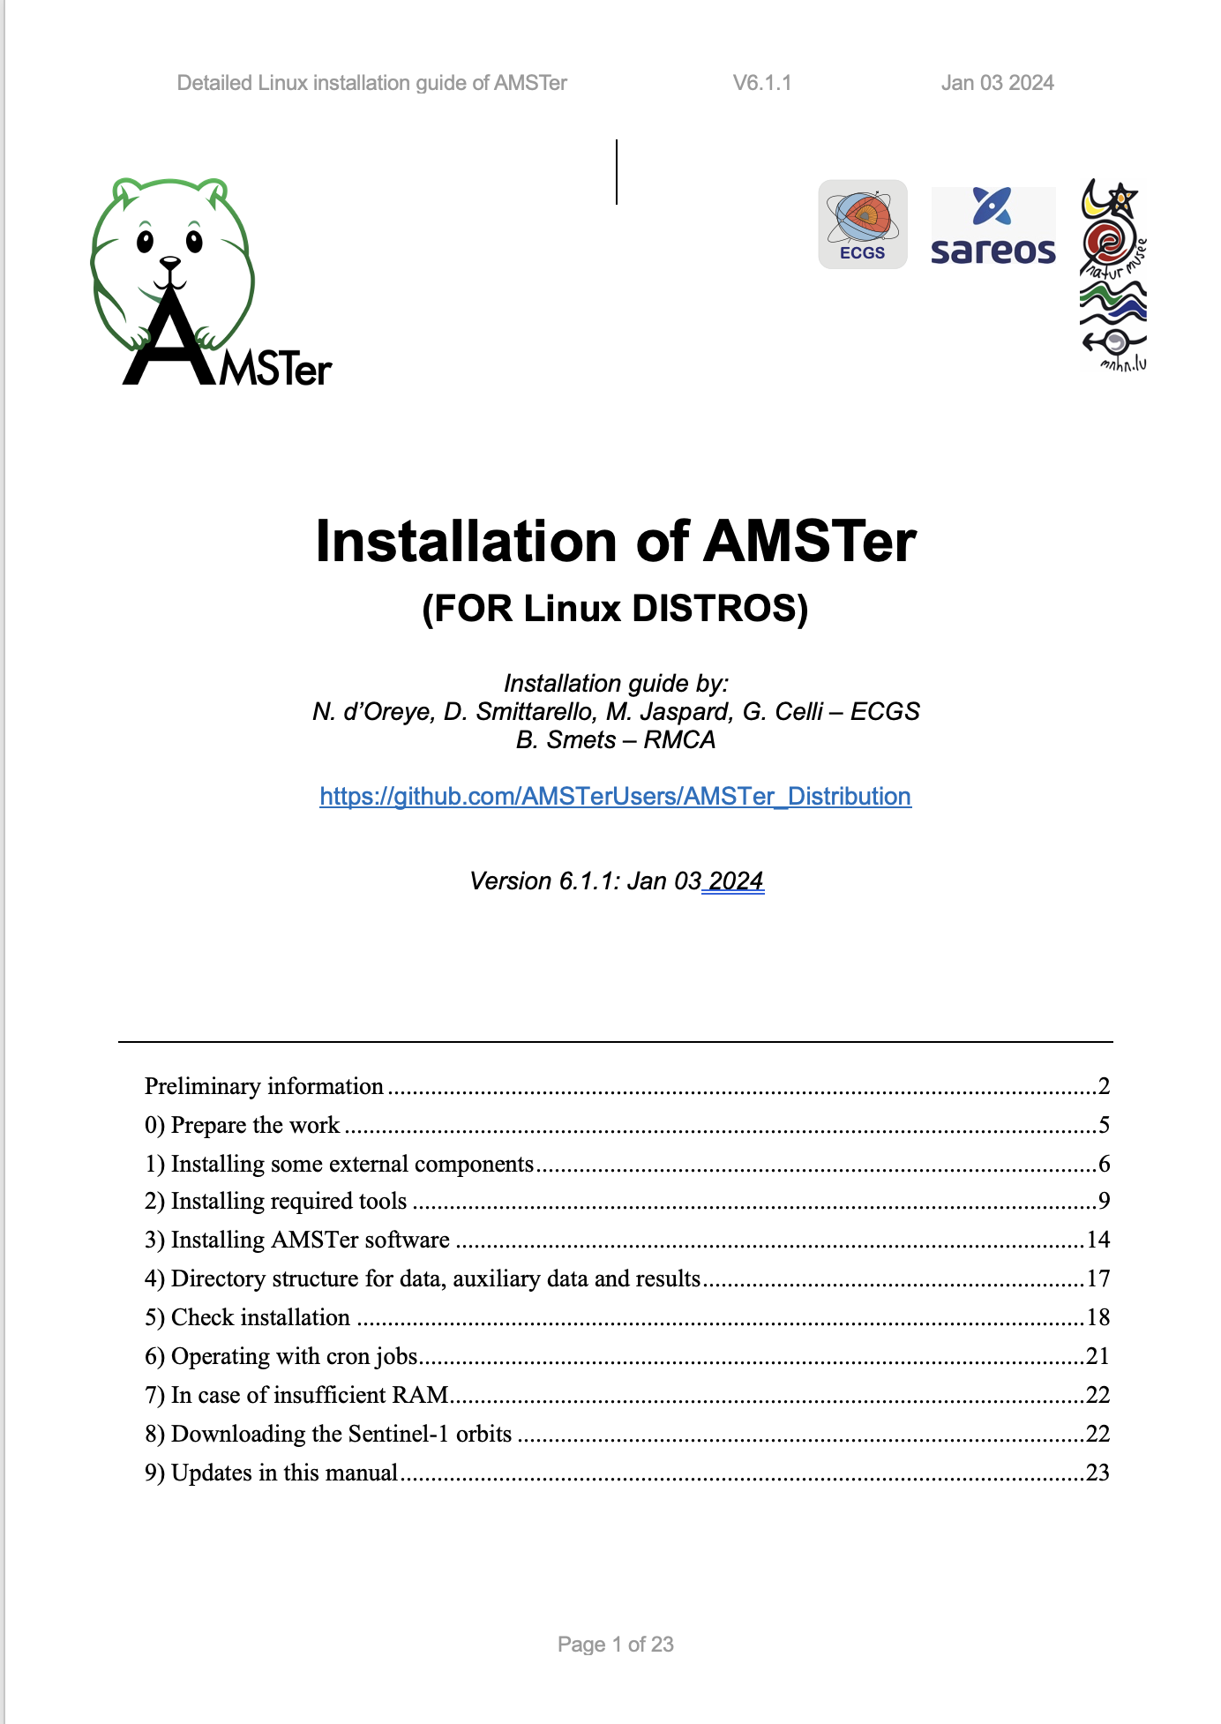
The user manual(s)
MasTer_Manual_6.2.docx [or .pdf]
250 pages
Clickable table of contents ………………………(from page3)
List of figures…………………………………………..(from page 238)
Index of scripts, variables, files names…….(from page 241)
Some references……………………………………..(from page 250)
Install_MasTer_Mac_V6.1.docx [or .pdf]
Install_MasTer_Linux_V6.1.docx [or .pdf]

Slide 8
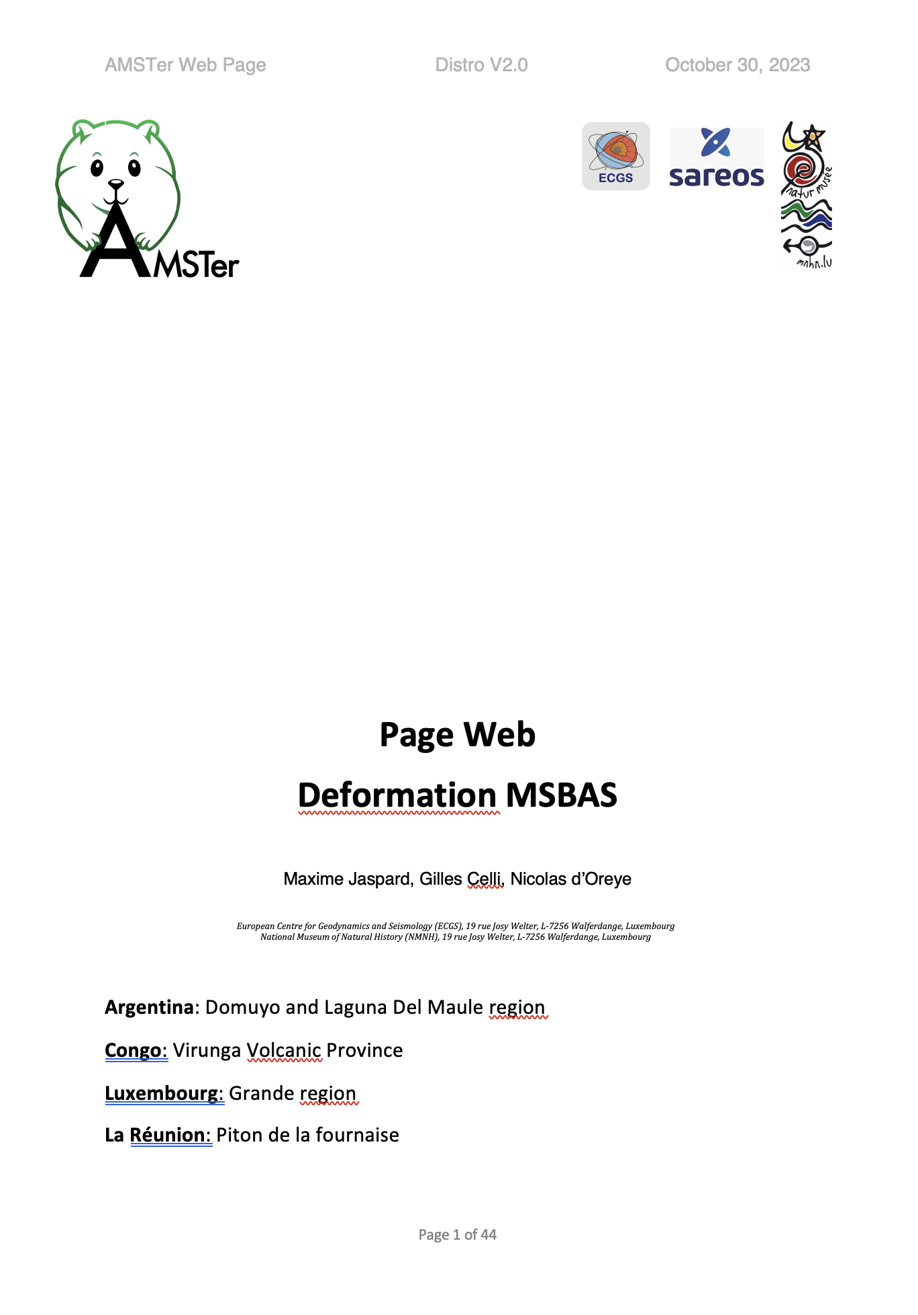
The user manual(s)
MasTer_Manual_5.0.docx [or .pdf]
216 pages
Clickable table of contents ………………………(from page3)
List of figures…………………………………………..(from page 207)
Index of scripts, variables, files names…….(from page 209)
Some references……………………………………..(from page 216)
Install_MasTer_Mac_V5.0.docx [or .pdf]
Install_MasTer_Linux_V5.0.docx [or .pdf]
Web_tool_V2.0.docx [or .pdf]

Slide 9
The user manual
MasTer_Manual_6.2.docx [or .pdf]
Conventions (hopefully):
Path are in green (“…/” at the beginning of a path means “whatever your path starts with”)
Parameters are in italic green
External commands or files are in italic blue
AMSTerEngine commands and scripts are in bold italic
Some warnings or important remarks are in red
Yellow highlight is coming soon (hopefully)
Parameters with square brackets (i.e. [..]) show in command lines are optional

Slide 10
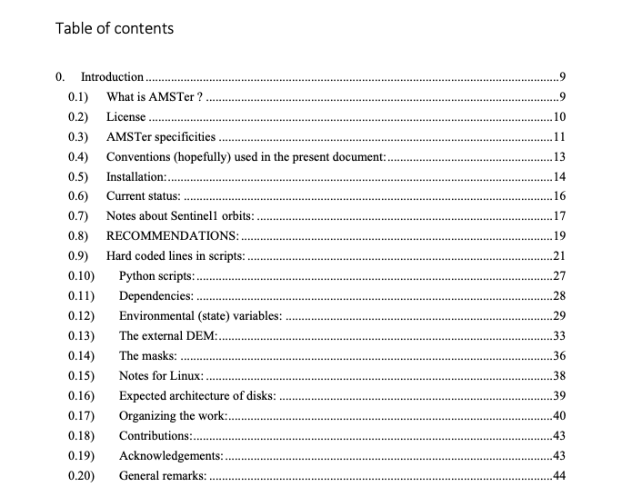
The user manual
AMSTer_Manual_6.2.docx [or .pdf]
Architecture:

Slide 11
The user manual
MasTer_Manual_6.2.docx [or .pdf]
Current status:
Constant improvements…
May happen that some functionalities did not survived updates. Let us know…
If not enough RAM: may experience problem at geocoding or MSBAS
Products are provided in UTM

Slide 12
The user manual
MasTer_Manual_6.2.docx [or .pdf]
Architecture:

Slide 13
The user manual
MasTer_Manual_6.2.docx [or .pdf]
Recommendations:
Keep same architecture even if not 4 hard drives
Keep same dir naming convention (& without fancy characters)
No FAT format hard drive (need symbolic links)
Do not forget hard coded lines in scripts (see later)

Slide 14
The user manual
MasTer_Manual_6.2.docx [or .pdf]
Architecture:
We will see that in a few minutes

Slide 15
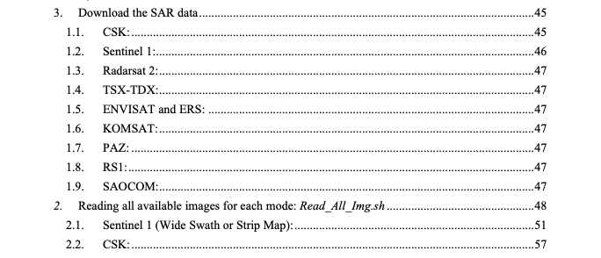
The user manual
MasTer_Manual_6.2.docx [or .pdf]
Architecture:
1.
Also TSX, TDX, ENVISAT, ERS, RS, PAZ, KOMPSAT, ALOS, SAOCOM, ICEYE…

Slide 16
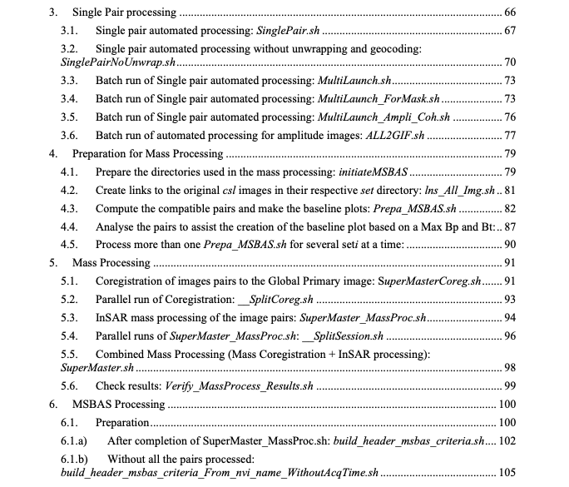
The user manual
MasTer_Manual_6.2.docx [or .pdf]
Architecture:
See ppt/pdf n° 3

Slide 17
The user manual
MasTer_Manual_6.2.docx [or .pdf]
Architecture:
See ppt/pdf n° 4

Slide 18
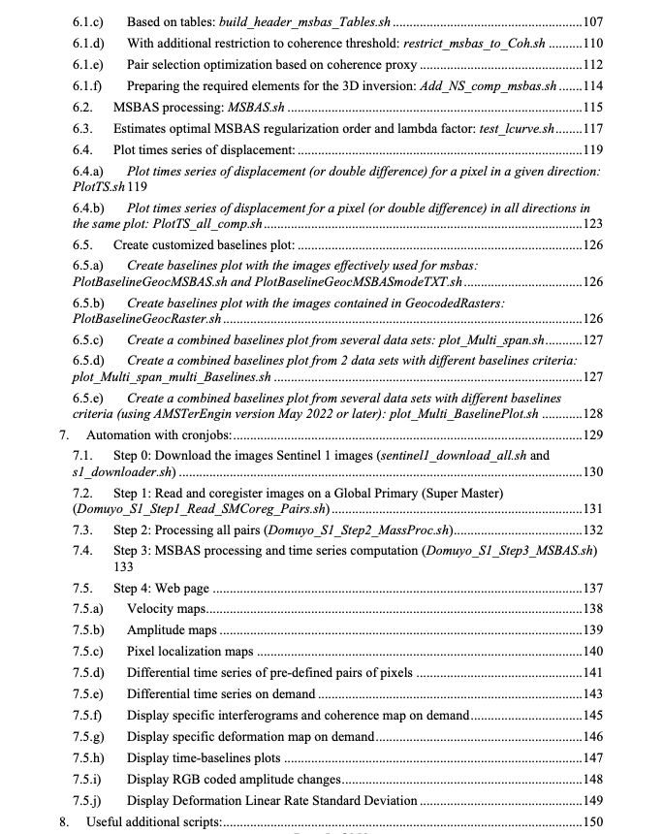
The user manual
MasTer_Manual_6.2.docx [or .pdf]
Architecture:
See ppt/pdf n° 5

Slide 19
The user manual
MasTer_Manual_6.2.docx [or .pdf]
Architecture:
See ppt/pdf n° 7
See ppt/pdf n° 12

Slide 20
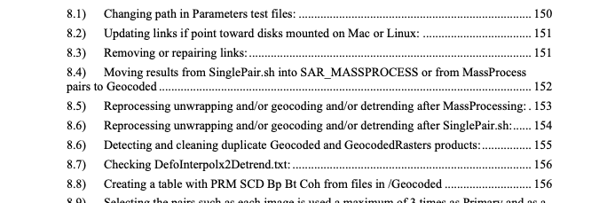
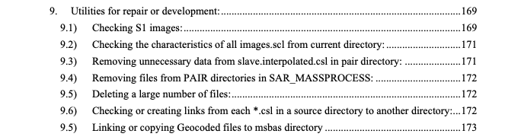
The user manual
MasTer_Manual_6.2.docx [or .pdf]
See ppt/pdf n° 10
Architecture:
There is a script for nearly
everything…
Etc, etc, etc…
See ppt/pdf n° 10
Etc, etc, etc…

Slide 21
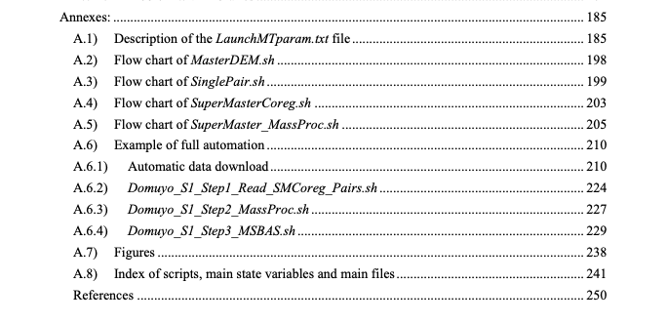
The user manual
MasTer_Manual_6.2.docx [or .pdf]
Architecture:
See here after

Slide 22
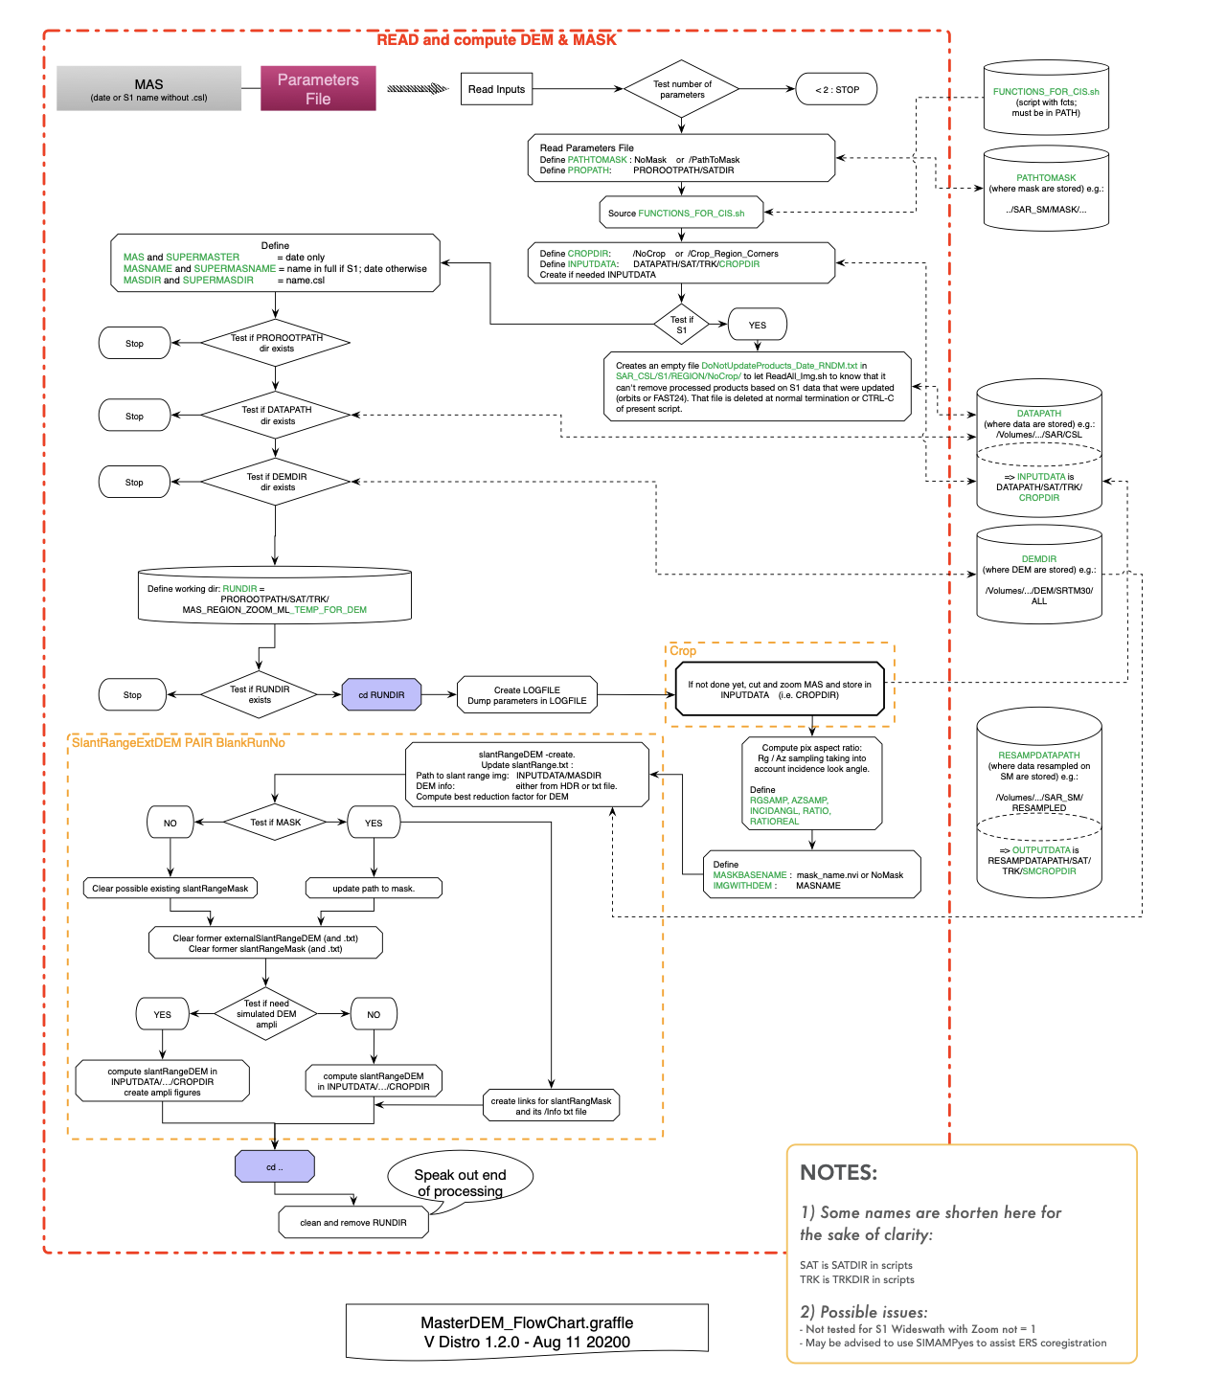
The user manual
MasTer_Manual_6.2.docx [or .pdf]
Architecture:
Provided only for assistance if need to track the logical path

Slide 23
The user manual
MasTer_Manual_6.2.docx [or .pdf]
Architecture:
May not be up-to-date
Check version !
Provided only for assistance if need to track the logical path

Slide 24
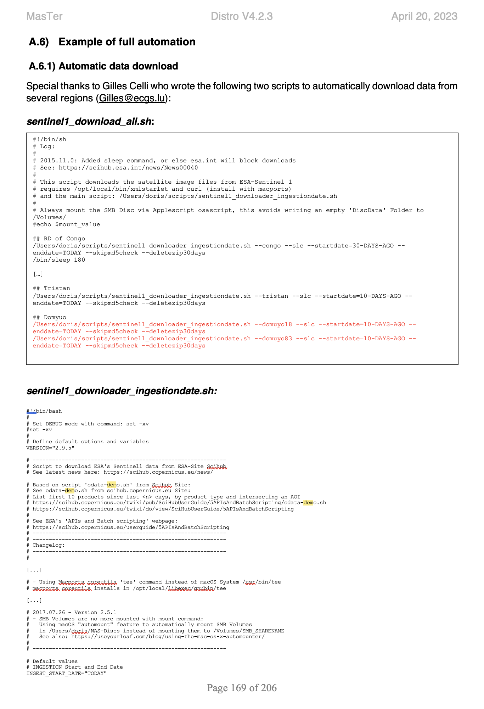
The user manual
MasTer_Manual_6.2.docx [or .pdf]
Architecture:
Refer to the most recent version of the cron scripts

Slide 25

The user manual
MasTer_Manual_6.2.docx [or .pdf]
Contest:
Whoever finds the most typos or bugs in the manual gets a beer.…

Slide 26
Structure
Plan:
The user manuals:
Conventions
Architecture
Contest…
Scripts architecture (header, hard coded lines..)
Organizing the work:
Disk/Directories architecture
AMSTer Organizer
Processing steps:
download,
read, (baseline computation)
Coregistration, InSAR processing, mass processing
Deformation time series (+ amplitude time series), web page
Parameters
Ancillary data:
DEM : where, how create, format
MASKS : where, how create, format
kml: where, why, how create
+ Provide samples (S1 data, DEM, orbits…) to participants

Slide 27
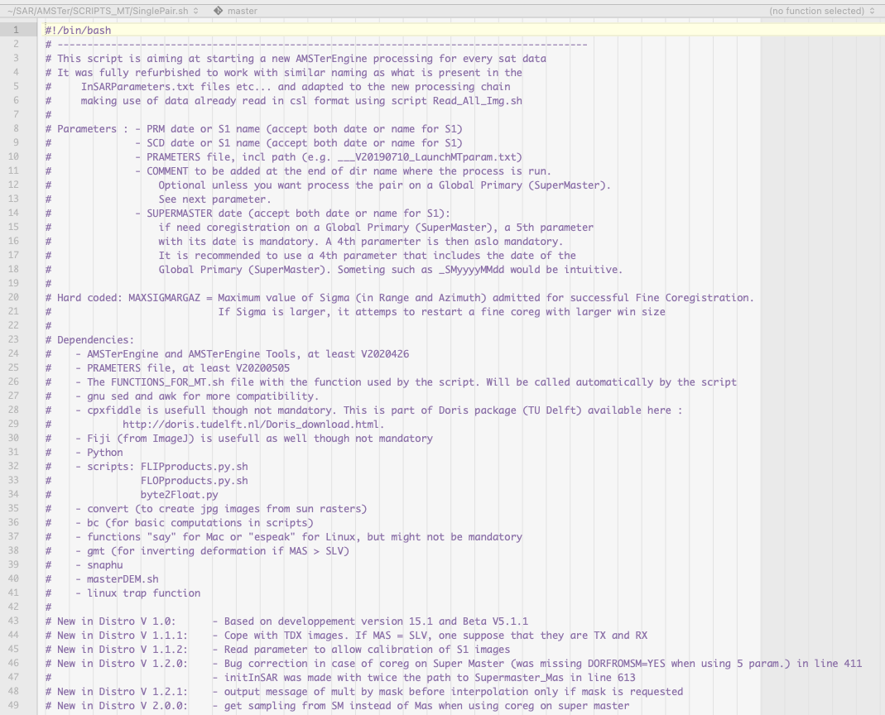
Scripts architecture
All the scripts have :
A shebang as first line (bash or python)
A header delimited by # with
Aim
List of parameters
Maybe some warnings :
where to launch the script
possible hard coded lines*…
Dependencies
List of changes in the new versions
* Hard coded lines are as much as possible merged into a file named __HardCodedLines.sh, which is sourced at the beginning of the file if required.

Slide 28
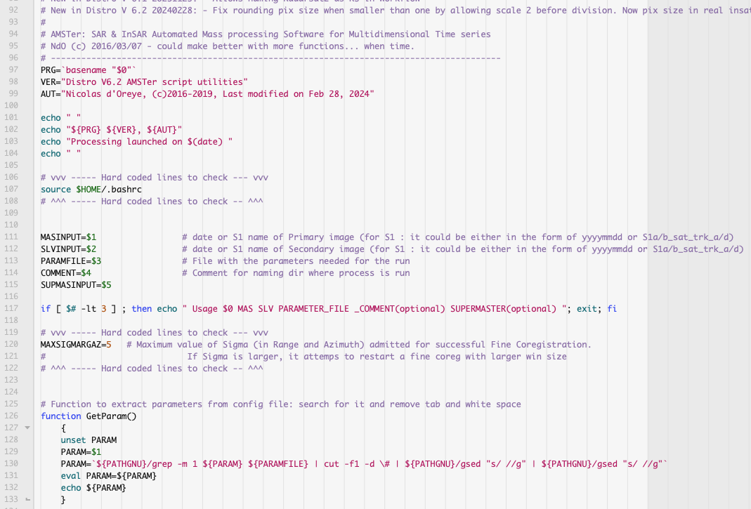
Scripts architecture
All the scripts have :
A header delimited by # with
[Some code to output
the name of the script,
its version and date
its author ]
[A line to source the .bashrc]
The capture of the parameters provided to the script
[Some tests on the parameters]
[Some hard coded lines, between vvvv--- and ^^^^---]
[Some functions, between {} ]

Slide 29
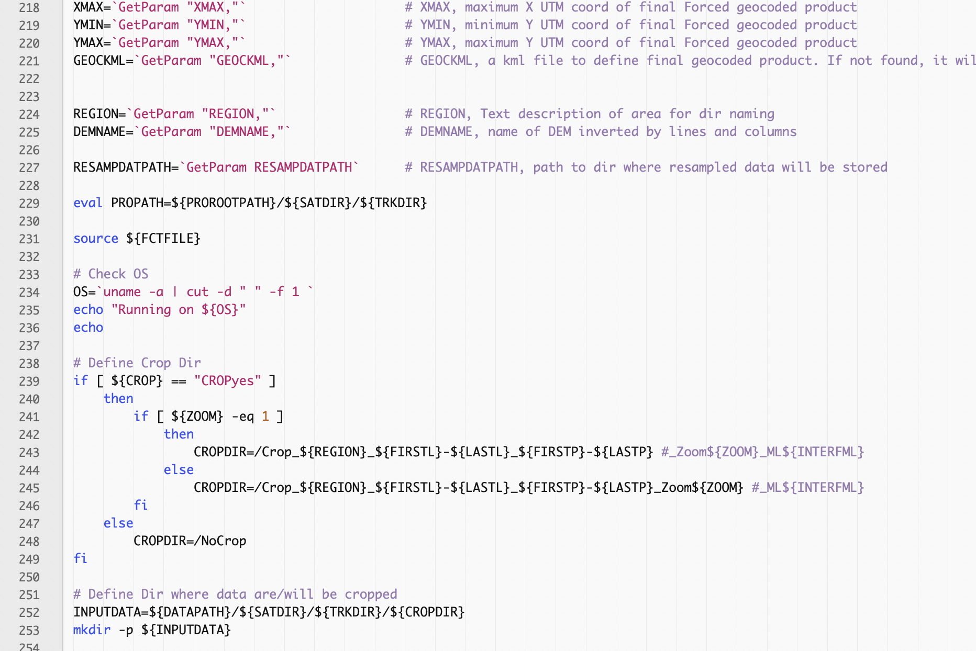
Scripts architecture
All the scripts have :
[The lecture of the parameters from the parameter file, see e.g. ___V20231026_LaunchMTparam.txt]
[Sourcing the FUNCTION_FOR_MT.sh script, i.e. a sort of library with functions]
[checking the OS]
The code (as commented as possible)

Slide 30
Scripts architecture
Main scripts are in: $HOME/SAR/AMSTer/SCRIPTS_MT
Some utilities are in: $HOME/SAR/AMSTer/SCRIPTS_MT/ zz_Utilities_MT
Some of less used utilities (mostly for “my” specific needs, though might be useful to other users) are in: $HOME/SAR/AMSTer/SCRIPTS_MT/zz_Utilities_MT_Ndo
Moreover,
cron scripts are in: $HOME/SAR/AMSTer/SCRIPTS_MT/_cron_scripts[_NEW]
MasTer Orginizer scripts are in:
$HOME/SAR/AMSTer/SCRIPTS_MT/AMSTerOrganizer
Scripts for pairs optimisation module are in:
$HOME/SAR/AMSTer/SCRIPTS_MT/optimtoolbox
Files for time series plots are in:
$HOME/SAR/AMSTer/SCRIPTS_MT/TSCombiFiles and $HOME/SAR/AMSTer/SCRIPTS_MT/TemplatesForPlots
Some Fiji related files for macro (for development) are in:
$HOME/SAR/AMSTer/SCRIPTS_MT/Fiji

Slide 31
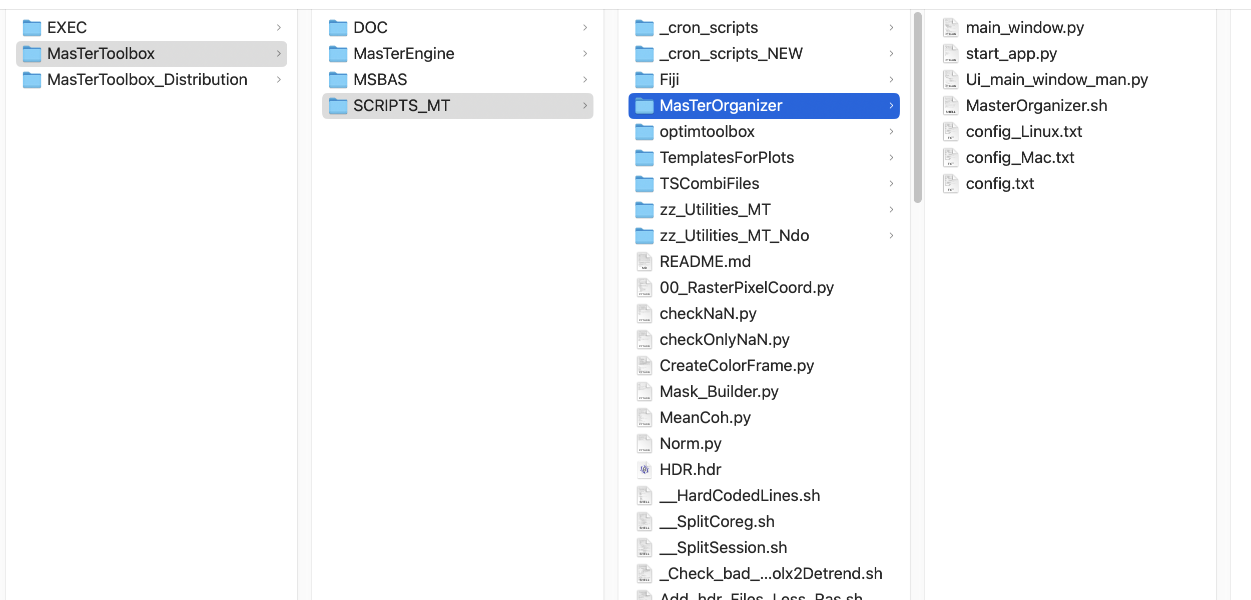
Scripts architecture
Cron scripts: $HOME/SAR/AMSTer/SCRIPTS_MT/_cron_scripts[_NEW]
AMSTer
AMSTerEngine
MasTer Orginizer: $HOME/SAR/AMSTe /SCRIPTS_MT/AMSTerOrganizer
AMSTerOrganizer
AMSTerOrganizer.sh
Utilities: $HOME/SAR/AMSTer/SCRIPTS_MT/zz_Utilities_MT
Less used utilities: $HOME/SAR/AMSTer/SCRIPTS_MT/zz_Utilities_MT_Ndo
Main scripts: $HOME/SAR/AMSTer/SCRIPTS_MT
Moreover,
$HOME/SAR/AMSTer/SCRIPTS_MT/TSCombiFiles contains files for time series plots.
$HOME/SAR/AMSTer/SCRIPTS_MT/Fiji contains some Fiji related files for macro (for development).
Note: Don’t be afraid if some scripts talk to you…
FUNCTIONS_FOR_MT.sh
Long names with lots of info…

Slide 32
Structure
Plan:
The user manuals:
Conventions
Architecture
Contest…
Scripts architecture (header, hard coded lines..)
Organizing the work:
Disk/Directories architecture
AMSTer Organizer
Processing steps:
download,
read, (baseline computation)
Coregistration, InSAR processing, mass processing
Deformation time series (+ amplitude time series), web page
Parameters
Ancillary data:
DEM : where, how create, format
MASKS : where, how create, format
kml: where, why, how create
+ Provide samples (S1 data, DEM, orbits…) to participants

Slide 33
Organizing the work
AMSTer Toolbox expects the files to be sorted in specific directories.
It will also store automatically the results in dedicated directories, based on your parameters and disk of your choice.
This is probably the most important part to remember: what is where.
If you respect these expected locations in your config, it will run smoothly.
Beware to stay consistent in your naming (e.g. use the same REGION and MODE description through the architecture).
In the following tables, we show what is expected for a typical architecture:

Slide 34
Organizing the work
Normal processing:
 | Raw data | Read data | Baseline tables | Coregistr. on SuperMaster | Mass Processed | MSBAS Time Series
disk | 3600 | 1650 | 1650 | 1650 | 3601 | 3602
dir | SAR_DATA |__S1 | |__S1_REG-SLC | |__S1_REG-SLC.UNZIP | |__S1_REG-SLC.UNZIP_FORMER | |__YYYY | : |__SAT |__REGION_MODE .. | SAR_CSL |__SAT |__REGION_MODE |__NoCrop | SAR_SM |__MSBAS |__REGION |__Set1 |__Set2 : | SAR_SM |__RESAMPLED |__SAT |__REGION_MODE | SAR_MASSPROCESS |__SAT |__REGION_MODE |__SM_Crop…. |__Geocoded |__GeocodedRasters |__Pair1 |__Pair2 : | MSBAS |__REGION_DESCRIPTION |__Mode1 |__Mode2… |__zz_EW.. |__zz_UD.. |__zz_LOS.. |__zz_EW_UD_TS..
Ancillary data:
 | DEM & GEOID | KML | MASK | Parameters & ORBITS | SCRIPTS | Points & events for Time Series
disk | DataSAR | 1650 | DataSAR | DataSAR | HOME | 1650
dir | SAR_AUX_FILES |__EGM | |__EGM96 | |__DEM |__SRTM30 | |__ALL | |__REGION.. |__Copernicus |__ALL |__REGION.. | kml |__REGION | SAR_AUX_FILES |__MASKS |__WaterBodies | |__REGION |__FOR_MASKS |__SAT |__REGION… | SAR_AUX_FILES |__ORBITS | |__S1_ORB | | |__AUX_RESORB | | |__AUX_POEORB | |__ENV_ORB… | |__Param_files |__SAT |__REGION_MODE | SAR |__AMSTer |__SCRIPTS_MT |___cron_scripts |__AMSTerOrganizer |__zz_Utilities_MT |__zz_Utilities_MT_Ndo | |__ EVENTS_TABLES | |__REGION | |__Data_Points |__REGION

Slide 35
Organizing the work
To assist you to remember where the things are (and to operate the tool), you can use AMSTer Organizer.
This is sort of a Graphical User Interface (GUI) developped with pyqt6.
It can be opened by launching at the Terminal (which can be closed after it was launched) the script AMSTerOrganiser.sh (located in SCRIPTS_MT/AMSTerOrganizer).
8 # MAX_BUTTON (Maximum number Button per line)
# Line 1 = top button area for direct access to data folder (RAW, SAR, AMPLI ...)
1_RAW_DATA # /$PATH_3600/SAR_DATA
1_CSL_DATA # /$PATH_1650/SAR_CSL
1_RESAMPLED # /$PATH_1650/SAR_SM/RESAMPLED
1_SETi # /$PATH_1650/SAR_SM/MSBAS
1_AMPLI # /$PATH_1650/SAR_SM/AMPLITUDES
1_MASSPROCESS # /$PATH_3601/SAR_MASSPROCESS
1_MSBAS # /$PATH_3602/MSBAS
# Line 2 = middle button area for direct access to scripts folder (cron, script_ok, utilities...)
2_SCRIPTS_MT # /$HOME/SAR/AMSTer/SCRIPTS_MT
2_CRON # /$HOME/SAR/AMSTer/SCRIPTS_MT/_cron_scripts
2_PARAM_FILES # /$PATH_1650/Param_files_SuperMaster
2_DEM # /$PATH_DataSAR/SAR_AUX_FILES/DEM
2_MASKS # /$PATH_DataSAR/SAR_AUX_FILES/MASKS
2_KML # /$PATH_1650/kml
2_EVENTS # /$PATH_1650/EVENTS_TABLES
2_POINTS_TS # /$PATH_1650/Data_Points
# Line 3 = low button area for direct access to folder from which we want to run scripts (ex: PlotTS.sh ...)
3_HOME # /$HOME/PROCESS
3_RUN_1650 # /$PATH_1650/PROCESS
3_RUN_3600 # /$PATH_3600/PROCESS
3_RUN_3601 # /$PATH_3601/PROCESS
3_RUN_3602 # /$PATH_3602/PROCESS
3_RUN_DellRack_DiskData # /Volumes/dellrack_data/PROCESS
3_RUN_Dell3_DiskData # /Volumes/dell3raid5/PROCESS
3_RUN_HP385_DiskData # /Volumes/HP385RAID5/PROCESS
AMSTerOrganiser.sh is configured by editing the file SCRIPTS_MT/AMSTerOrganizer/config_OS.txt.
That’s where buttons displayed at the top (separated by light grey line) are named and their corresponding paths are defined.
Button names are written with a one digit heading defining the section where it will be displayed

Slide 36
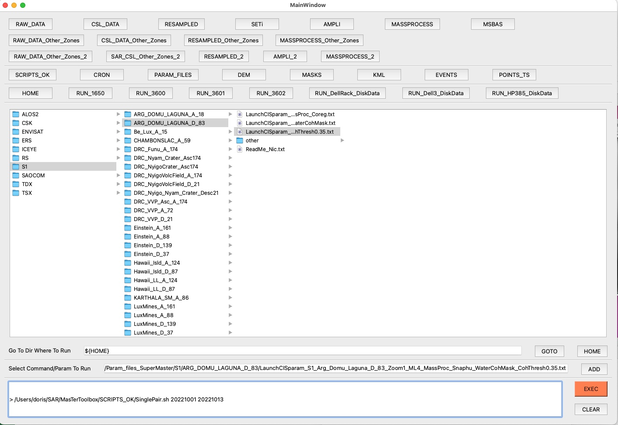
Organizing the work
Normal progression in processing
Ancillary data
Some processing directories on several disks
Displays the content of the directory selected by a button above
Where to go to execute the command
Select/write the command or the parameter to add to the command line
AMSTer/SCRIPTS_MT/SinglePair.sh 20221001 20221013
Command line to execute when ready

Slide 37
Structure
Plan:
The user manuals:
Conventions
Architecture
Contest…
Scripts architecture (header, hard coded lines..)
Organizing the work:
Disk/Directories architecture
AMSTer Organizer
Processing steps:
download,
read, (baseline computation)
Coregistration, InSAR processing, mass processing
Deformation time series (+ amplitude time series), web page
Parameters
Ancillary data:
DEM : where, how create, format
MASKS : where, how create, format
kml: where, why, how create
+ Provide samples (S1 data, DEM, orbits…) to participants

Slide 38
Processing steps
It depends on what you want to do. There is however some common steps:
Download the data (see manual)
Read the data: Read_All_Img.sh
Then if you want to compute a single interferogram for ground deformation measurement or DEM generation:
Compute the interferogram and geocoding: SinglePair.sh
Then if you want to compute a time series of ground deformation:
Compute the list of pairs [and search for the Super Master] (& baseline plot): Prepa_MSBAS.sh
Coregister every image on the Super Master: SuperMasterCoreg.sh
Compute all the interferometric pairs: SuperMaster_MassProc.sh (maybe perform some preliminary tests with SinglePair.sh)
Prepare the msbas-required files : build_header_msbas_criteria.sh
Run the MSBAS inversion: MSBAS.sh
[Search for most appropriate MSBAS inversion parameters: test_lcurve.sh]
[Plot some (double difference) time series: PlotTS.sh or PlotTS_all_comp.sh]
[Make your web page to display/share results]
Then if you want to compute a time series of amplitude images:
Only in slant range, with a gif [cropped] animation tagged with dates, for all pairs SM-SLV: ALL2GIF.sh
or
In slant range and in geographical coordinates, for all pairs in a provided list: MultiLaunch_Ampli_Coh.sh
See also e.g. automatised procedures in cron jobs provided as examples (they also contains several tools for checking files)

Slide 39
Processing steps
Information about downloads (see also chapter 1 in manual):
CSK:
Often provided all mixed (ascending and descending, different modes etc…)
Provided with fancy names
See manual for scripts to assisting in sorting these data :
ReadDateCSK.sh
Prepa_CSK.sh
Prepa_CSK_SuperSite.sh
S1 (IW & SM):
Need to download the data (see example of script in Toolbox) and store in …/SAR_DATA/S1/S1-DATA-TARGET-SLC
Unzip them and store them in a directory named (see manual) …/SAR_DATA/S1/S1-DATA-TARGET-SLC.UNZIP (May use Unzip_S1.sh to unzip all S1 images from a directory)
TSX/TDX:
May need Prepa_TSX.sh to change the name and check their acquisition modes and/or footprints. See manual

Slide 40
Processing steps
Information about reading the images (see also chapter 2 in manual):
S1 (IW & SM):
After reading with Read_All_Img.sh, for the sake of efficiency, raw images older than 6 months will be moved from …/SAR_DATA/S1/S1-DATA-TARGET-SLC.UNZIP to …/SAR_DATA/S1/S1-DATA-TARGET-SLC.UNZIP_FORMER/yyyy
Read_All_Img.sh will NOT attempt to read again images stored in …_FORMER/yyyy unless you ask him by adding the parameter ForceAllYears. Doing so also force to check updated orbits for images in …_FORMER/yyyy.
While attempting to read new data, the script will also check if orbits were updated. Indeed images are provided with preliminary orbits, updated with final ones after 3 weeks. If a new orbit is available:
It will update the image in SAR_CSL
It will move the following products already computed with the preliminary orbit
The coregistration on the Super Master ➔ in SAR_SM/RESAMPLED/S1_CLN
The mass processed pairs ➔ in SAR_MASSPROCESS/S1_CLN
providing that you launched Read_All_Img.sh with the place were resampled and mass processed pairs are stored as parameters

Slide 41
Processing steps
Information about reading the images (see also chapter 2 in manual):
S1 (IW & SM):
Reading S1 IW images allows selecting all and only the bursts overlapping an area of interest. If needed, it will stitch bursts from several frames. The area of interest is provided as a kml file when running Read_All_Img.sh. Beware: at processing, if using a kml for cropping, ensure to use the same kml or a smaller one to avoid re-stitching bursts in your pair processing directory (huge waste of time and disk space).
Img 1
Img 2
AOI

Slide 42
Processing steps
Information about reading the images (see also chapter 2 in manual):
S1 (IW & SM):
Note: Do not name two S1 REGION with the same beginning of name followed by an underscore (e.g. do NOT use REGION and REGIONX_TEST; you can, however, use for instance REGIONTEST)
Several modes of S1 images may be present in SAR_DATA/S1/ S1-DATA-TARGET-SLC.UNZIP. After reading them, the script sort the images by mode, e.g in SAR_CSL/S1/REGION SAR_CSL/S1/REGION_MODE1 SAR_CSL/S1/REGION_MODE2 (where MODEs are eg A_174, D_21 etc…). The first directory, SAR_CSL/S1/REGION, must contain a link to each image stored in _MODEs
Bad images can be put in SAR_CSL/S1/REGION_MODE1/Quarantained to be further ignored

Slide 43
Processing steps
Information about reading the images (see also chapter 2 in manual):
S1 IW:
Some tools exist to check the size and number of bursts in S1 image read (e.g. _Check_S1_SizeAndCoord.sh and _Check_ALL_S1_SizeAndCoord_InDir.sh ; see scripts or manual).
CSK:
May want to use ReadModeCSK.sh to assist sorting CSK modes after reading
TDX & TSX:
May want to use SORT_TDX.sh to assist sorting TDX (Bistatic or Pursuit mode) or TSX images if several footprints are read at the same time. See script or manual.
ENVISAT:
If data were obtained at the time of their acquisition, it can be read immediately.
If they were obtained from a recent bulk download at ESA, running MoveBulkEnvisat_InSubDirs.sh may be necessary before reading.

Slide 44
Structure
Plan:
The user manuals:
Conventions
Architecture
Contest…
Scripts architecture (header, hard coded lines..)
Organizing the work:
Disk/Directories architecture
AMSTer Organizer
Processing steps:
download,
read, (baseline computation)
Coregistration, InSAR processing, mass processing
Deformation time series (+ amplitude time series), web page
Parameters
Ancillary data:
DEM : where, how create, format
MASKS : where, how create, format
kml: where, why, how create
+ Provide samples (S1 data, DEM, orbits…) to participants

Slide 45
Parameters
All the processing is based on a file that contains all the necessary parameters: see template …/SAR/AMSTer/SCRIPTS_MT/___V20231026_LaunchMTparam.txt. (See manual, Annexe A.1)
After a header, it contains the values of the parameters. Each parameter value is followed by “# STRING,” (where STRING is the name of the variable) then some words of explanation about that parameter.
# PARAMETERS TO RUN SCRIPT LAUNCHING AMSTer Engine.
# PARAMETERS MUST BE FOLLOWED BY A # AND ITS VAR NAME FOLLOWED BY COMA.
# (DESCRIPTION, THOUGH THIS IS OPTIONAL)
# AS READING THIS FILE IS MADE USING FIRST OCCURENCE OF SEARCH CRITERIA,
# DO NOT ADD TEXT WTH VARIABLE NAME FOLLOWED BY COMA.
# ALWAYS KEEP THE PATH PARAMETERS AT THE BOTTOM
#
# VERSION Oct 26 2023
# AUTOMATIC FIGURES DISPLAY
###########################
FIGyes # FIG, option to compute or not the quick look using cpxfiddle
POPno # POP, option to pop up figs created with cpxfiddle, or POPno
# DATA
######
S1 # SATDIR, Satellite system (must be the same as dirname structure: RADARSAT, TSX, TDX, CSK, S1, ENVISAT)
LUX_A_15 # TRKDIR, Processing directory and dir where data are stored E.g. SM/Asc160 (must be the same as dirname structure)
# For mass processing only
###########################
20170429 # SUPERMASTER, date of the Global Primary as selected by Prepa_MSBAS.sh in
# e.g. /Volumes/hp-1650-Data_Share1/SAR_SM/MSBAS/Bukavu/seti/setParametersFile.txt
ATTENTION:
Values are case sensitive!
Parameter value must be followed by # STRING followed by a coma.
The description that follows the coma is optional though.
File reading from scripts search for first occurrence of the parameter’s name followed by a coma. Hence, do not put several lines with different values of the same variable.
Do not add text with the variable name followed by coma in the description.
Always keep the path parameters at the bottom of the file.
Example of LaunchMTparam.txt

Slide 46
Parameters
[…]
#
# VERSION Oct 26 2023
# AUTOMATIC FIGURES DISPLAY
###########################
FIGyes # FIG, option to compute or not the quick look using cpxfiddle
POPno # POP, option to pop up figs created with cpxfiddle, or POPno
# DATA
######
S1 # SATDIR, Satellite system (must be the same as dirname structure: RADARSAT, TSX, TDX, CSK, S1, ENVISAT)
LUX_A_15 # TRKDIR, Processing directory and dir where data are stored E.g. SM/Asc160 (must be the same as dirname structure)
# For mass processing only
###########################
20170429 # SUPERMASTER, date of the Global Primary as selected by Prepa_MSBAS.sh in
# e.g. /Volumes/hp-1650-Data_Share1/SAR_SM/MSBAS/Bukavu/seti/setParametersFile.txt
# DEM
###########
GreaterRegion # DEMNAME, name of DEM (in mathematical order). Need txt file in same dir
SIMAMPno # SIMAMP, compute Simutaled Amplitude during Ext Dem Generation - usually not needed (maybe ERS). SIMAMPno or SIMAMPyes
KEEP # RECOMPDEM, recompute DEM or mask in slant range even if already there (FORCE), or check the one that would exist (KEEP).
# DO NOT RUN TWO "FORCE" OR A "FORCE" AND A "KEEP" PROCESS AT THE SAME TIME USING SAME PRIMARY
# It may cause prblm if externalSlantRangeDEM and maybe slantRangeMask are being modified by the first FORCE run.
# CROP
###########
/$PATH_1650/SAR_CSL/S1/LUX/Lux.kml # CROP, CROPyes or CROPno, or for S1, path to kml that will be used to define area of interest.
10000 # FIRSTP, Crop limits: first point (row) to use
8000 # FIRSTL, Crop limits: first line to use
24000 # LASTP, Crop limits: last point (row) to use
12000 # LASTL, Crop limits: last line to use
1 # ZOOM, factor during crop
LUX # REGION, Text description of area for dir naming
[…]
Compute quicklook files (SUN rasters) and pop them up
Name of the satellite. Beware of name (must be as coded in scripts) !
Name of the track. Beware of name (must be as dir names) !
Date of Super Master (for mass processing only; see manual § 4.2)
Name of DEM (Path is given at the end of this file)
KEEP will avoid recomputing DEM in slant range geometry if it exists already. FORCE will do it, even if exist.
CROPyes or CROPno the image. If yes, for all but S1 IW, set Crop region in LINES/PIXELS numbers, or with LAT/LONG coordinates.
For S1 IW (not SM !), set Crop region by providing with a kml file instead of CROPyes. Keep it smaller than the one used for reading!
Zoom factor: oversample the data
Name to describe the cropped region (also used in dir naming)

Slide 47
Parameters
[…]
# AMPLITUDE
###########
4 # MLAMPLI, Multilooking factor for amplitude images reduction (used for coregistration - 4-6 is appropriate).
# If rectangular pixel, it will be multiplied by corresponding ratio.
SQUARE # PIXSHAPE, pix shape for product : SQUARE, ORIGINALFORM, SQUAREUNITY or ORIGINALFORMUNITY
SIGMANO # CALIBSIGMA, if SIGMAYES it will output sigma nought calibrated amplitude file (for S1 only)
# COARSE COREG
##############
64 # CCOHWIN, Coarse coreg window size (64 by default but may want less for very small crop).
# Can be set to 0 to skip coarse coreg when using god orbit sat such as TSX, TDX and Envisat
0.4 # COH, Coarse Coherence threshold coregistration
24 # CCDISTANCHOR, Coarse registration range & az distance between anchor points [pix] (eg 24 for large img, 16 for medium and 2-8 for very small crops)
# FINE COREG
############
7 # FCOHWIN, Fine coreg window size (eg 3 for ERS/ENV or 7 for CSK, TSX and RS; must have win of eg 50 pixels; computed on full resol img)
0.5 # FCOH, Fine Coherence threshold coregistration
24 # FCDISTANCHOR, Fine registration range & az distance between anchor points [pix] (eg 24 for large img, 16 for medium and 2-8 for very small crops)
# INSAR
########
DEFO # PROCESSMODE, DEFO to produce DInSAR or TOPO to produce DEM (used only in SinglePair.sh)
VV # INITPOL, For multi pol images; force polarisation at initInSAR for InSAR processing. If it does not exists it will find the first compatible PRM-SCD pol.
50 # LLRGCO, Lower Left Range coord offset for final interferometric products generation. Used in SinglePairNoUnwrap only for Shadow measurements
50 # LLAZCO, Lower Left Azimuth coord offset for final interferometric products generation. Used in SinglePairNoUnwrap only for Shadow measurements
4 # INTERFML, multilook factor for final interferometric products generation (to multiply to the LARGEST side of the pixel); when used with zoom, it is ML to apply to zommed pixels
1 # FILTFACTOR, filtering factor for interfero (2 might be too strong when used with POWSPECSMOOTFACT filtering)
1 # POWSPECSMOOTFACT, Power spectrum filtering factor (for adaptative filtering) (0 = no filtering; 1 or less is possible though stronger)
2 # COHESTIMFACT, in pixels. Must be similar to INTERFML as far as it is not a ML higher than 5 or 7 non ML for instance. For ML1, if -le 1, will be forced to 2.
# If INTERFML is larger than 5 or 7, limit anyway COHESTIMFACT to 5 or 7 (Remember: computations load goes as square of win size)
# MASK
#######
APPLYMASKyes # APPLYMASK, Apply mask (bytes, LatLong, Envi Harris, larger than img) before unwrapping (APPLYMASKyes or APPLYMASKno);
# Mask for AMSTer Engine < 20230928: 1 = keep, 0 = mask. However, at unwrapping, 0-masked pixels are kept if their coh > COHCLNTHRESH
# Mask for AMSTer Engine > 20230928: 0 = keep, 1 = always mask, 2 = mask. However, at unwrapping, 2-masked pixels are kept if their coh > COHCLNTHRESH
# If a mask is requested but no Snaphu, one can also mask manually files with ffa (eg ffa residualInterferogram.HH-HH.f x slantRangeMask)
/$PATH_DataSAR/SAR_AUX_FILES/MASKS/WaterBodies/DRCongo/LakeKivu_LatLong_0keep # PATHTOMASK, geocoded mask file name and path
[…]
Multilooking factor for COREGISTRATION only
Shape of final pixel: square for defo. Maybe original for amplitude time series.
S1 IW sigma nough amplitude calibration
Characteristics of coarse and fine coregistration:
Size of the sub windows
Threshold (if coh <, not taken into account)
Distance between subwindows
DEFO or TOPO processing
Preferred polarisation
Corner offset when stacking amplitude image in slant range (see manual § 3.2)
Multilooking factor of interferometric products
Filters
Coherence estimation factor
Use a mask or not and give its full path

Slide 48
Parameters
[…]
# UNWRAPPING
############
SKIPno # SKIPUW, SKIPno unwraps and geocode all products, SKIPyes skips unwrapping and
# geocode only available products, Mask geocode only ampli and coh (for mask geenration)
SNAPHU # UW_METHOD, Select phase unwrapping method (SNAPHU, CIS, DETPHUN1ONLY, DETPHUN2ONLY,
# DETPHUN1SNAPHU, DETPHUN2SNAPHU, DETPHUN1CIS, DETPHUN2CIS)
# if snaphu unwrapping:
1.2 # DEFOTHRESHFACTOR, Snaphu : Factor applied to rho0 to get threshold for whether or not phase discontinuity is
# possible. rho0 is the expected, biased correlation measure if true correlation is 0. Increase if not good.
0.9 # DEFOCONST, Snaphu : Ratio of phase discontinuity probability density to peak probability density expected for
# discontinuity-possible pixel differences. Value of 1 means zero cost for discontinuity, 0 means infinite cost. Decrease if prblm.
0.2 # DEFOMAX_CYCLE, Snaphu : Max nr of expected phase cycle discontinuity. For topo where no phase jump is expected, it can be set to zero.
DEFO # SNAPHUMODE, Snaphu : TOPO, DEFO, SMOOTH, or NOSTATCOSTS.
ZoneMapYes # ZONEMAP, if ZoneMapYes, it will create a map with the unwrapped zones named snaphuZoneMap.
# Each continuously unwrapped zone is numbered (from 1 to...)
0.00001 # ZONEMAPSIZE, Minimum size of unwrapped zone to map (in frazction of total nr of pixels)
300 # ZONEMAPCOST, Cost threshold for connected components (zones). Higher threshold will give smaller connected zones
50 # ZONEMAPTOTAL, Maximum number of mapped zones
MultiSnaphuNo # MULTIUWP, MultiSnaphuYes performs recursive snaphu unwrapping (need 4 params below).
# MultiUnwrapNo (or any other string) will perform single snaphu unwrapping
ResidInterfFilt # WHICHINTERF, which interferogram to unwrap, ResidInterf (residual interfero) or ResidInterfFilt (residual interfero filtered)
0.9 # COEFREQ, Coefficient of increase of cut-off frequency
12.5 # CUTINI, Initial cut-off frequency (e.g. 12.5 for a 400x400 image, 10 for a 2200x1500 img)
10 # NITMAX, Max total nr of iterrations
0.0627 # COHMUWPTHRESH, coh threshold (between 0 and 1) below which it replaces the phase by white
# noise (corresponding mask will be produced). If set to 0, do not mask with white noise
# if snaphu or CIS unwrapping:
0.25 # COHCLNTHRESH, Coherence cleaning threshold. Snaphu gives 0 weight at pixels below that threshold.
# Moreover, if a mask is used, snaphu (or CIS) also unwraps 0-masked pixels (for AMSTer Engine < 20230928)
# or 2-masked pixels (for AMSTer Engine > 20230928) if their coherence is above COHCLNTHRESH.
# if CIS unwrapping:
0.1 # FALSERESCOHTHR, False Residue Coherence Threshold: higher is much slower. Use max 0.15 e.g. in crater
3 # CONNEXION_MODE,number of times that connexion search radius is augmented when stable connections are found ; 0 search along all coh zone
3 # BIASCOHESTIM, Biased coherence estimator range & Az window size (do not apply pix ratio)
3 # BIASCOHSPIR, Biased coherence square spiral size (if residual fringes are not unwrapped decrease it; must be odd)
# if DETPHUN unwrapping:
3 # DETITERR, Number of iterration for detPhUn (Integer: 1, 2 or 3 is generaly OK)
0.3 # DETCOHTHRESH, Coherence threshold
[…]
Skip unwrapping or not, which method
Parameters for each unwrapping method…
Map of successfully unwrapped region. Each disconnected region is a new zone.
See manual § 3.4

Slide 49
Parameters
[…]
BOTH # INTERPOL, interpolate the unwrapped interfero BEFORE or AFTER geocoding or BOTH.
DETREND # REMOVEPLANE, if DETREND it will remove a best plane after unwrapping. Anything else will ignore the detrending.
# GEOCODING
###########
UTM # PROJ, Chosen projection (UTM or GEOC – GEOC OPTION IS NOT READY YET)
Forced # GEOCMETHD, Resampling Size of Geocoded product: Forced (at FORCEGEOPIXSIZE - mandatory for further MSBAS),
# Auto (closest multiple of 10), Closest (closest to ML az sampling), ClosestMassProc (Closest even for a Mass Process),
LetCIS # RADIUSMETHD, LetCIS (CIS will compute best radius) or forced to a given radius
TRI # RESAMPMETHD, TRI = Triangulation; AV = weighted average; NN = nearest neighbour
LORENTZ # WEIGHTMETHD, Weighting method : ID = inverse distance; LORENTZ = lorentzian
1.0 # IDSMOOTH, ID smoothing factor
1.0 # IDWEIGHT, ID weighting exponent
1.0 # FWHM, Lorentzian Full Width at Half Maximum
1 # ZONEINDEX, Zone index
100 # FORCEGEOPIXSIZE, Pix size wanted eg as you want for your final MSBAS database
# UTMZONE, letter of row and nr of col of the zone where coordinates below are computed (e.g. U32)
225000 # XMIN, minimum X UTM coord of final geocoded product
426000 # XMAX, maximum X UTM coord of final geocoded product
5417000 # YMIN, minimum Y UTM coord of final geocoded product
5593000 # YMAX, maximum Y coord of final geocoded product
/$PATH_1650/kml/ # GEOCKML, a kml file to define final geocoded product. If not found, it will use the coordinates above
#########
# PATHS #
#########
/$PATH_3601/PROCESS/AS # PROROOTPATH, path to dir where data will be processed in sub dir named by the sat name (SATDIR).
/$PATH_1650/SAR_CSL/ # DATAPATH, path to dir where data are stored
/$PATH_DataSAR/SAR_AUX_FILES/DEM/SRTM30/ALL # DEMDIR, path to dir where DEM is stored
/$PATH_SCRIPTS/SCRIPTS_MT/FUNCTIONS_FOR_MT.sh # FCTFILE, path to file where all functions are stored
# for coregistration mass processing (required if coresitration on a Global Primary i.e. SuperMaster)
/$PATH_1650/SAR_SM/RESAMPLED # RESAMPDATPATH, path to dir where resampled data will be stored
# for insar mass processing
/$PATH_3601/SAR_MASSPROCESS/ # MASSPROCESSPATH, path to dir where all processed pairs will be stored in sub dir named by
# the sat/trk name (SATDIR/TRKDIR)
May interpolate VERY SMALL gaps in deformation maps before and/or after geocoding or none
Only UTM products (except maybe some amplitude time series)
Force geocoded product to given grid, with given resolution. MANDATORY when performing MSBAS. Closest will instead provide with geocoded pixel size as close as possible as pixel size in radar geometry (on flat surface)
Method to re-grid the geocoded products
Path to several directories where to find/store data and results

Slide 50
Structure
Plan:
The user manuals:
Conventions
Architecture
Contest…
Scripts architecture (header, hard coded lines..)
Organizing the work:
Disk/Directories architecture
AMSTer Organizer
Processing steps:
download,
read, (baseline computation)
Coregistration, InSAR processing, mass processing
Deformation time series (+ amplitude time series), web page
Parameters
Ancillary data:
DEM : where, how create, format
MASKS : where, how create, format
kml: where, why, how create
+ Provide samples (S1 data, DEM, orbits…) to participants

Slide 51
Ancillary data
The Digital Elevation Model (DEM):
Mandatory for DInSAR, (helpful for TOPO).
Must have the following specificities:
Referred to ellipsoidal heights, not to the geoid.
In the mathematical order (i.e. origin = lower left corner ; not the GIS order, which origin = upper left corner)
AMSTer Engine (AE) format = a binary matrix + a header file named with a .txt extension.
Also accept ENVI format (binary matrix + a header file named with a .hdr extension). Attention, if ENVI and AE format exist in directory, the tool will consider only the AE format.
Must be stored in a directory indicated in the LaunchMTparam.txt file (do not use a state variable)

Slide 52
Ancillary data
The Digital Elevation Model (DEM):
How to create it (see manual p. 25) ?
Using agregateSRTMTile AMSTer Engine function and srtm tiles:
Log to http://earthexplorer.usgs.gov (Login and pwd required. Account can easily be created).
Download the srtm1 tiles in BIL format.
Move the files in a dedicated dir (e.g. $PATH_DataSAR/SAR_AUX_FILES/DEM/DEM_REGION).
Uncompress the files and delete the zip files. You stay with several subdirs where .bil, .blw, .hdr and .prj files are stored for each tile.
Ensure you have in your .bashrc a state variable named EARTH_GRAVITATIONAL_MODELS_DIR=$PATH_DataSAR/SAR_AUX_FILES
and that it contains a directory named /EGM96 that contains the Geoid file named WW15MGH.DAC (downloaded from web).
Launch the command : agregateSRTMTiles $PATH_DataSAR/SAR_AUX_FILES/DEM/DEM_REGION
From another source, using the script DEM_Envi_hdr2AMSTer_txt.sh:
Example with a Copernicus DEM : download the tif tiles
Merge them with QGIS for instance (Processing toolbox -> GDAL/OGR -> Miscellaneous -> Merge as Float32, BIL or tif)
Run the following command: DEM_Envi_hdr2AMSTer_txt.sh YOUR_PATH_TO/Your_COPERNICUS_DEM.tif
When the script will ask if “your DEM referred to the Ellipsoid (E), Geoid (G) or you do not know (Q)”, answer G (for Geoid). It will then refer your Copernicus DEM in AMSTer format to the Ellipsoid as expected by AMSTer. Indeed, following the Copernicus documentation, the horizontal reference datum is WGS84-G1150; EPSG 4326 and the vertical reference datum is the Earth Gravitational Model 2008 (EGM2008; EPSG 3855), that is EGM2008 geoid undulation values with respect to WGS84.

Slide 53
Ancillary data
The MASK:
AMSTer Engine can mask interferograms at the unwrapping step (see manual § 0.14).
For that, it expects a mask with the following characteristics:
must be envi Harris (not ESRI) (!)
zone must be GREATER than image,
in Lat Long (not UTM !)
in Bytes, filled with 1 or 0 (no NaN !!)
You can find several scripts to transform files to such a kind of characteristics (see annexes).
Trick:
ESRI: it uses nrows and ncols for image size. ➔ BAD FORMAT
HARRIS: it uses lines and samples for image size ➔ GOOD

Slide 54
Ancillary data
The MASK:
Example how create a mask:
Rough procedure to create a mask based on water bodies shape file.
Download a shape file
Process a SinglePair.sh with a Forced geocoding (no need to unwrap) on an area larger than the images you will need to mask
In QGIS import the shape file and a copy (because original file will be changed) of the coherence computed here above
RASTERIZE from GDAL toolbox:
Input layer = shape
Input raster = coherence
Fixed value to burn = 2
Raster Calculator:
If (coherence < 2 , 0 ,1)
Save as “mask”
Output format = ENVI.hdr (not ESRI !)
As Lat Long (if needed, use the gdal command gdalwarp -of ENVI -t_srs EPSG:4326 UTMfileName LLfileName)
Replace NaN with zeros in mask (e.g. using NaN2zero.py)
Transform floats to bytes (e.g. using float2byte.py)
Copy the mask.hdr as mask.zeroBytes.hdr
Edit mask.zeroBytes.hdr and change “data type = 4” with “data type = 1”

Slide 55
Ancillary data
The kml:
Kml files are needed to
read some files,
crop some files,
define area of interest where to compute e.g. a mean value etc…
Kml files can be creates e.g. with Google Earth:
Define a polygon
Give it a name and save it
Right click on that polygon
Click on “Save place as” , select kml (not kmz) and save it in the directroy of your choice
Reminder: With S1 IW, beware to keep same or smaller kml for processing than for reading. See manual § 2.1

Slide 56
Structure
Plan:
The user manual:
Conventions
Architecture
Contest…
Scripts architecture (header, hard coded lines..)
Organizing the work:
Disk/Directories architecture
AMSTer Organizer
Processing steps:
download,
read, (baseline computation)
Coregistration, InSAR processing, mass processing
Deformation time series (+ amplitude time series), web page
Parameters
Ancillary data:
DEM : where, how create, format
MASKS : where, how create, format
kml: where, why, how create
- DONE ! -

